Slide 1

What is the unique contribution of Enabling Good Lives that will make the greatest positive difference in the lives of disabled people in the Waikato?

Slide 2
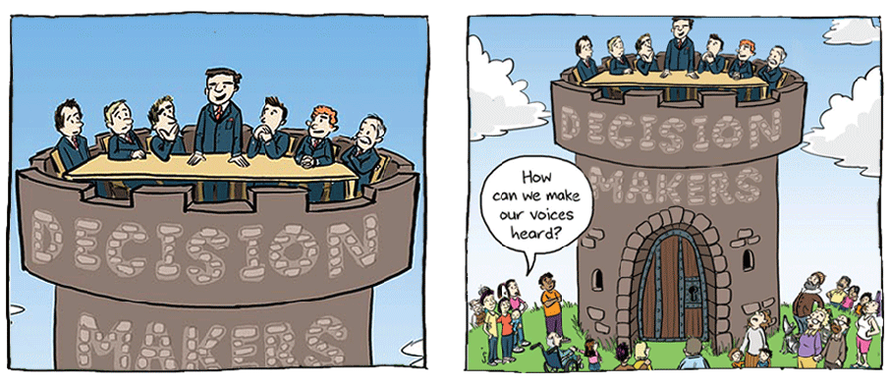
Why are we doing it?
Notes:
Complex system hard to understand and negotiate through for providers let alone disabled people – example of family forum EIF, IF, Choices in Community, New Model, Local Area Coordination.

Slide 3

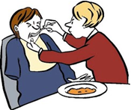
Some disabled people, families and whānau get information but some don’t.
Some disabled people have choice in all aspects
of their lives but some don’t.
Notes:
and when

Slide 4
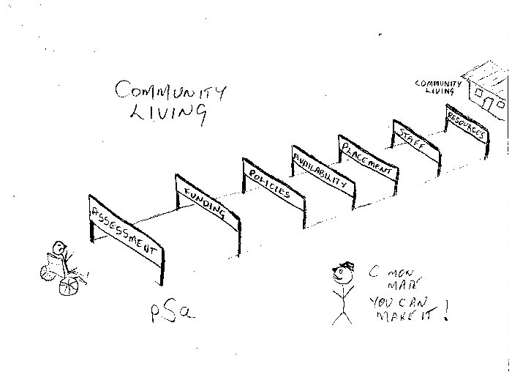

Slide 5
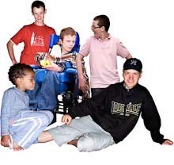

Some disabled children and young people have
the same life experiences as other children
and young people but some
don’t.
Some disabled people get paid jobs
but some don’t.
Notes:
EGL will take action in these areas.

Slide 6
Key outcomes for the Waikato demonstration – disabled people.
I am in control of my life and what happens to me.
I can contribute to the lives of others and to my community.
I have one plan and one amount of funding.
I can choose who will assist me with my ongoing support.
Notes:
What will be different ? I can go to Farmers and buy what I want with my own money. If I need help trying something on I can choose the salesperson I want (not the grumpy one!).

Slide 7
Key outcomes for the Waikato demonstration - families and whānau
My family, whānau and I understand the parts of the disability system relevant to my situation and what that means for us.
We are known and connected in our community.
We know how to, and can access all the information our family and whānau needs.

Slide 8
Key outcomes for the Waikato demonstration -
families and whānau
We have access to support and funding that contributes to our family and whānau living the life we want.
We know how to access support and funding at the time we need it.

Slide 9
Key outcomes for the Waikato demonstration – Māori disabled and their whānau.
To be determined by disabled Māori and their whānau, Iwi and Te Piringa.

Slide 10
Key outcomes for the Waikato demonstration –employment.
I have networks and connections that assist me in finding work.
I have peers that can help me achieve my goals.
I have paid work that matches my skills and interests.

Slide 11
Key outcomes and actions for the Waikato demonstration – employment
I have opportunities to further my career development.
I have the supports I need so I succeed at work.

Slide 12
What will change if we use an Enabling Good Lives approach?
There will be one set of principles, one person, one plan, one pool of funding and one evaluation.
Disabled people, families and whānau will choose who will guide them through the planning and funding process.
Notes:
We are aiming for one system This includes building on Choices in Community Living.

Slide 13
What will change if we use an Enabling Good Lives approach?
The leadership of disabled people, families and whānau will be stronger.
Providers will develop creative approaches to individual support.
Community building will be woven through each action area.

Slide 14
What does it mean for providers
How can you get involved
Volunteers
Next steps

