Slide 1
Ministry of Health
Enabling Good Lives
Disability System Transformation
16th June 2017
PART A
Horizontal products

Slide 2
These documents summarise the work on the high level design for transforming the disability support system, which will be start to be rolled out through a prototype in the mid-Central region in July 2018.
This system transformation has been co-designed with disabled people, whānau, service organisations and government representatives.
The key transformation elements contained in Part A | Horizontal documents include:
A high-level experience map for the disability support system
An overview of the system
A high-level roadmap to make the prototype in the mid-Central region a reality
The key transformation elements contained in Part B | Portrait documents include:
The high-level system elements and the more detailed system elements by each phase
An Enabling Good Lives persona set, against which the high-level design was tested throughout the design process
Where the term disabled person is used, this refers to a disabled person of any age and includes children, young people, adults and older people with disabilities. Where the term whānau is used, this refers to whānau or family as defined or described by the disabled person.

Slide 3
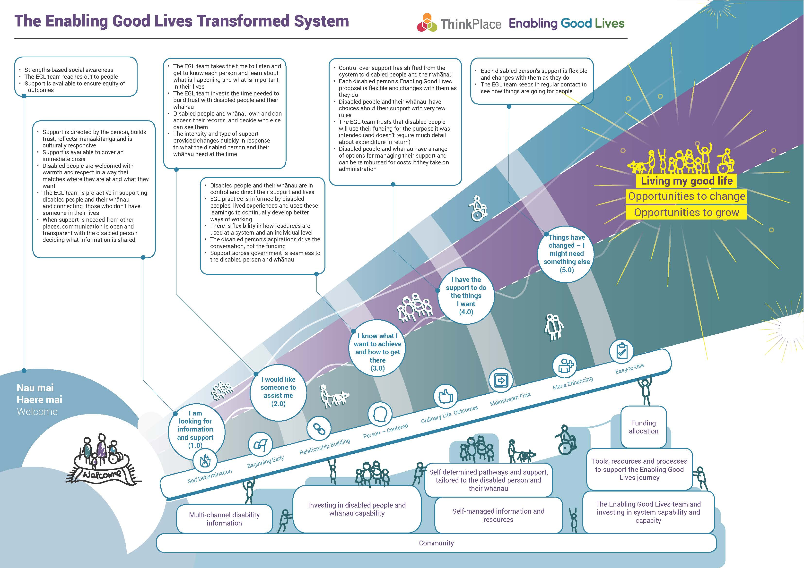

Slide 4
ENABLING GOOD LIVES NEW SYSTEM HIGH LEVEL EXPERIENCE
Enabling Good Lives Principles: self determination, beginning early, person-centered, ordinary life outcomes, mainstream first, mana enhancing, easy to use, relationship building
 |  | 1.0 I/we know what support and assistance is available | 2.0 I/we are listened to and respected | 3.0 I/we work out what we want to do and how to get there | 4.0 I/we make it happen | 5.0 I/we live the life we want
Overview | A person finds out they, or a family member, have an impairment and want to know more | It is easy to find out about disability support and there is widespread awareness at whānau, community and the system level | There are proactive and responsive entry points for everyone | The Enabling Good Lives team provides a space for thinking about possibilities, and responds in a way that enables the life that the disabled person and whānau wants | The Enabling Good Lives team assists the disabled person and whānau to put support in place that works for them | Disabled people continue to live the lives they want, have new experiences and connect with others
Gateway
Disabled Person | “Something has changed or I could have more in my life.” | “I know there is support for me and I know there is someone to walk alongside me and help me work things out, on my terms.” | “I am listened to, respected and responded to in a way that works for me.” | “I’m making decisions about my life and I’m supported to do this in a way that builds the life I want. I have mana.” | “I am in control of my supports and am connected with people and places I enjoy.” | “I am continuing to build the life I want and have flexible support to assist me”
Whānau | “We are facing some challenges or life could be better for us." | “We know there is support for our whole whānau. I know who to talk to about getting support.” | “We are listened to, respected and responded to in a way that works for all of the whānau.” | “Our whānau know where we are heading and have supports in place to build the life we want together.” | “We are in control of our support, and our disabled family member, along with our whānau, are stronger.” | “We know that if things change for our whānau and disabled family member our supports are flexible and can change with us.”
Other People | “I can see someone might benefit from some information or support." | ““I know what support, resources and information is available and am going to offer this. I know what my role is, I'm confident and capable. I'm going to actively help.” | “I have the time, skills and the resources to truly listen and respond in a way that works for you and your whānau.” | “I’m there to assist you and your whānau, work out what you want to achieve and how to get the supports and resources you need to make this a reality. I’m the ‘support crew’ while you are in the driving seat.” | “ I am alongside to assist as you manage your supports, try new experiences and deal with difficult times”. | “I reflect and learn from the opportunities I have to support disabled people and their whanau”.
Critical System Shifts | Strengths-based social awareness The EGL team reaches out to people Support is available to ensure equity of outcomes | Support is directed by the person, builds trust, reflects manaakitanga and is culturally responsive Support is available to cover an immediate crisis Disabled people are welcomed with warmth and respect in a way that matches where they are at and what they want The EGL team is pro-active in supporting disabled people and their whānau and connecting those who don’t have someone in their lives When support is needed from other places, communication is open and transparent with the disabled person deciding what information is shared | The EGL team takes the time to listen and get to know each person and learn about what is happening and what is important in their lives The EGL team invests the time needed to build trust with disabled people and their whānau Disabled people and whānau own and can access their records, and decide who else can see them The intensity and type of support provided changes quickly in response to what the disabled person and their whānau need at the time | Disabled people and their whānau are in control and direct their support and lives EGL practice is informed by disabled peoples’ lived experiences and uses these learnings to continually develop better ways of working There is flexibility in how resources are used at a system and an individual level The disabled person’s aspirations drive the conversation, not the funding Support across government is seamless to the disabled person and whānau | Control over support has shifted from the system to disabled people and their whānau Each disabled person’s Enabling Good Lives proposal is flexible and changes with them as they do Disabled people and their whānau have choices about their support with very few rules The EGL team trusts that disabled people will use their funding for the purpose it was intended (and doesn’t require much detail about expenditure in return) Disabled people and whānau have a range of options for managing their support and can be reimbursed for costs if they take on administration | Each disabled person’s support is flexible and changes with them as they do The EGL team keeps in regular contact to see how things are going for people
System Building Blocks
I am looking for information
and support
I would like someone to assist me
I am ready to talk about what I
want in my life
I know what I want to achieve and
how to get there
I have the support to do the things
I want
Things have
changed – I might need something else
Investing in disabled people and whānau capability
Self-managed information and resources
Tools, resources and processes to support the Enabling Good Lives journey
The Enabling Good Lives team and investing in system capability and capacity
Multi-channel disability information
Self determined pathways and support, tailored to the
disabled person and their whānau
Funding allocation (including funding model, allocation
and processes)

Slide 5
Enabling Good Lives High level roadmap
KEY
This roadmap indicates the large segments of work needing to be done to enable the new system. Each line signals the need for a detailed project plan.
Milestone
Decision point
Prototype development plan
Prototype agreed
Goes live
Try, learn, adjust
Disability Information front end
Getting ready for mid-central prototype
Investing in disabled people and whānau capability
Self-managed information and resources
Self determined pathways and support
Building system elements
Tools, resources and processes
Prototype readiness
Prototyping iteration 1
Prototyping iteration 3
Final iteration for roll out
Prototyping iteration 2
Funding allocation
Creating the Enabling Good Lives team
System responsiveness
Detailed design of interface with government systems
* Disabled people; Families/whānau; Providers; workforce; Government agencies; NASC
MidCentral Regional leadership group established
Engaging in key local audiences*
Understand implications
Implement decisions
Try, learn, adjust
Deep dive for Māori
Build into prototype
High + complex framework
Build into prototype
Transition to new funding arrangements
Works streams to support implementation
Scope of funding
Transition planning
Deep dive for providers
Procurement planning
Implement procurement plan
Understanding market shaping function
Implement
Financial implications
Information Technology development
Identify policy issues
Policy proposals
Policy and legislative changes
Current state baseline data gathering
Implement evaluation
Evaluation plan
Engagement on design
End-to-end system oversight: Regional; co-design group; National EGL leadership group
Testing with specific groups
Engaging key audiences*
Change readiness assessment*
Develop transition plans
Implement transition plans
Change management
Capability building*
Ensuring continuity of services
Communication
Regular monthly updates
Social media strategy
Celebrating Success
Celebration
Celebration
Horizon 1
In preparation for the mid-Central prototype
July 1 2018
Horizon 2
MidCentral prototype
July – Dec 2019
Horizon 3
Beyond MidCentral

