Slide 1
Mana Whaikaha A new disability support system starts on 1 October 2018
What do you need to know about the changes?

Slide 2
Overview
Enabling Good Lives vision and principles
What will the new system look like on 1 October?
What does this mean for you?
Questions
Notes:
Today we are going to talk about the prototype of the transformed disability support system that is rolling out in MidCentral region from 1 October 2018. We are going to talk about:
What the government is trying to achieve through this change that is based on the Enabling Good Lives vision and principles
What we know about what the new system will look like on 1 October
What this will mean for our organisation and for you
We also want to make sure there is a chance for you to ask questions.

Slide 3
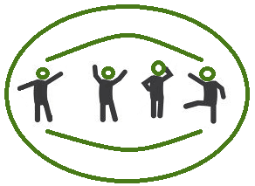
Why are things changing?
Disabled people and families have been asking for:
More flexible support options
More control over their support and lives
Currently there is a fixed menu of support – not tailored to individual
An opportunity to bring funding together
Poorer outcomes than peers and rising costs
Notes:
Disabled people and whanau have been calling for change for a long time in New Zealand – culminated in a Select Committee Enquiry in 2008 and government response in 2009
Disabled people and families are telling us that they want greater control over their support and lives
Current system provides one size fits all support – not tailored to the individual and their circumstances
Support and funding is fragmented/siloed across government – organised around government agencies not disabled people
Currently, it’s all about what the system needs (eg assessments for eligibility), not the disabled person and their families
Poorer outcomes than peers
Rising costs - evidence unclear about cost effectiveness

Slide 4
Based on Enabling Good Lives vision …
In the future, disabled children and adults and their families will have greater choice and control over their supports and lives, and make more use of natural and universally available supports.
EGL is an approach led by disabled people and whānau
Notes:
The new system is based on the Enabling Good Lives vision and principles that were developed by a group of disabled people, families and providers in 2011.
The vision focuses on:
Disabled people and families having more flexible support options
Disabled people and families making more decisions over their support and lives

Slide 5
and principles…
self determination
beginning early
person centred
ordinary life outcomes
mainstream first
mana enhancing
easy to use
relationship building
Notes:
There are 8 principles.
You may want to get people to discuss what each principle means and how they can apply it the principle in their work
Self-determination
Disabled people are in control of their lives.
Beginning early
Invest early in families and whānau to support them; to be aspirational for their disabled child; to build community and natural supports; and to support disabled children to become independent, rather than waiting for a crisis before support is available.
Person-centred
Disabled people have supports that are tailored to their individual needs and goals, and that take a whole life approach rather than being split across programmes.
Ordinary life outcomes
Disabled people are supported to live an everyday life in everyday places; and are regarded as citizens with opportunities for learning, employment, having a home and family, and social participation - like others at similar stages of life.
Mainstream first
Everybody experiences full participation and inclusion within their community (people, places, assets, infrastructure and supports) as of right and can choose funded supports to enhance and facilitate this
Mana enhancing
The abilities and contributions of disabled people and their families are recognised and respected.
Easy to use
Disabled people have supports that are simple to use and flexible.
Relationship building
Supports build and strengthen relationships between disabled people, their whānau and community.

Slide 6
A new system will be in place on 1 October …
Everyone who is accessing disability support in MidCentral will be in new system from 1 October
There will be two new teams replacing the NASC
Nothing will change for disabled people and whānau unless they contact the new team
Disabled people and whānau will continue to need and will receive high quality disability support
Notes:
The new disability support system will be in place for everyone accessing Disability Support Services funded by the Ministry of Health and everyone who is eligible for disability support
There will be two new teams replacing the NASC:
A disabled people facing team made up of connectors
A team that supports the connectors
Disabled people and whanau will continue to receive the support they were getting on 30 September until they proactively contact the system to make changes or until their regular check
Disabled people will continue to need support

Slide 7
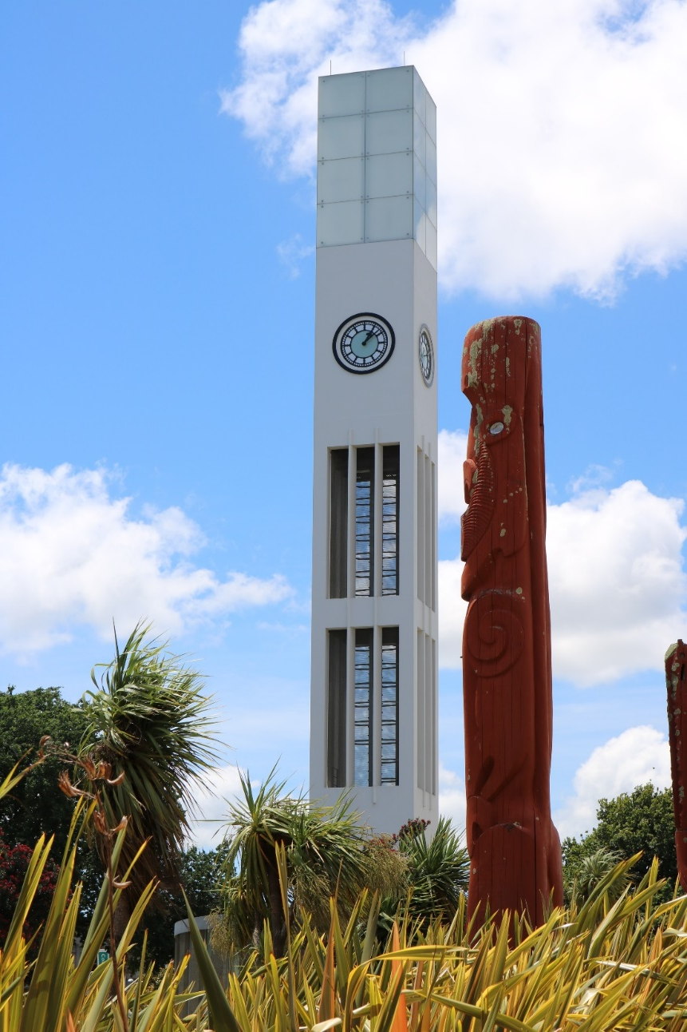
Why MidCentral?
1,600 people use disability support services
20 % Māori
Mix urban and rural
MidCentral area includes:
Palmerston North
Horowhenua
Manawatu
Ōtaki
Tararua districts.
Notes:
The MidCentral DHB region includes, Palmerston North, Horowhenua, Manawatu, Ōtaki and the Tararua districts.
There are 1,600 people accessing Disability Support Services, of these users 20% are Māori. There is a good mixture of urban and rural users.

Slide 8
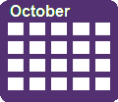
What will be in place on 1 October?
People are welcomed into the system
Access to Connectors
Easy to use information and processes
Connected support across government
Streamlined funding with flexibility
Capability funding
Disabled people and whānau involved in governance
Notes:
People are welcomed into the system in multiple ways, and are then provided with information and linked with a Connector and peer network
Access to Connectors who can walk alongside disabled people and whānau, if they choose, to help them identify what they want in their lives, and the supports available
Easy to use information/processes to meet the diverse needs of disabled people
Connected support across government, with people in the background who assist in accessing other government services, ie learning support in school
Funding is flexible about what support can be purchased and easy reporting on how it has been used
Capability funding to build the skills of disabled people and whānau
Greater system accountability to disabled people and whānau who are involved in the monitoring and evaluation of the new system.

Slide 9
Try, learn and adjust
A ‘try, learn and adjust’ approach will be taken in MidCentral before the roll out across New Zealand
Disabled people and their whānau are involved in governance arrangements, monitoring and evaluating the model
Advice will be provided to Cabinet on the final model and expanding beyond the MidCentral region, in late 2020
EGL will continue the way it is in Christchurch and the Waikato until the transformation starts in their area
Notes:
A ‘try, learn and adjust’ approach will be taken for the MidCentral prototype to refine and finalise the model for rollout across New Zealand.
Disabled people and their whānau will be involved in governance arrangements, monitoring and evaluation.
Monitoring & evaluation by disabled people & whanau - Disabled people will be involved in assessing the new system
Advice will be provided to Cabinet on the final model and expanding the transformed system beyond the MidCentral region in late 2020.
Officials will work with a working group involving disabled people and whānau representatives to develop recommendations for organisational arrangements for the transformed disability support system.

Slide 10
There will be two new teams in place
Kaitūhono/Connectors team
Connectors and a Network Builder
Connectors will be an ally for disabled people and their whānau
Tari/System team
This team has Disability Information, Government Liaison, administration, Funding Co-ordinator roles
Notes:
The Kaitūhono/Connector team, is the disabled people will engage with the most. The Tari/System team will be doing a lot of work in the back office.

Slide 11
Our response to the new system
Notes:
Providers might want to tailor a slide about what you are doing to respond to the new system

Slide 12
What does this mean for you?
Your current employment arrangement, terms and conditions will continue on 1 October
Disabled people and whānau:
may start asking for different types of disability support – this may create opportunities for providing different types of support
want to make more decisions about their support and lives – this will change how you work with them
will have more options about how they access support including more flexible funding
who employ people need to meet all employment obligations including pay equity.
Notes:
As more control is given is disabled people and their whānau it might change the way they work.
Possible changes are -
Disabled people and whānau may start asking for different types of disability support – this may create opportunities for providing different types of support, and the way they receive them.
This will allow us to be creative and have more flexibility about how we deliver services.
Disabled people and whānau will have more options about how they access support including more flexible funding and contracting, they may choose to use one provider to host their budget and get their supports from
somewhere else.
Everyone who is currently employed, will continue to be employed when the new system starts on 1 October. We do expect some disabled people and their whānau to employ support staff directly. The will have the same employment obligations as providers, including pay equity.

Slide 13
What does this mean for you?
There may be opportunities to:
Have more flexible work options
Work differently and support disabled people to make more decisions in their lives
There will be information, advice and support available for employees and employers within new system
Notes:
Continuing on from the previous slide.
There will be opportunities for disabled people and whānau to directly employ support workers and we expect some to do this. If you were to be employed directly there may be flexibility in terms of the hours and days you work.
If you are employed by a disabled person or their whānau, there may be an opportunity to mutually agree on conditions including; times, location and frequency.
The new system has been working on material to provide information and advice to both disabled people and whānau who are employers and support workers who will be directly employed.

Slide 14
Questions
Notes:
An opportunity for those you are presenting to, to ask questions.

Slide 15
How to find out more and for updates
Website www.enablinggoodlives.co.nz/system-transformation
Livestreaming Question and Answer sessions with Ministry of Health’s Sacha O’Dea www.youtube.com/enablinggoodlives
Contact the System Transformation team
STFeedback@moh.govt.nz

