Slide 1

AN INTRODUCTION TO The Enabling Good Lives Approach
Resource 1 of 3

Slide 2
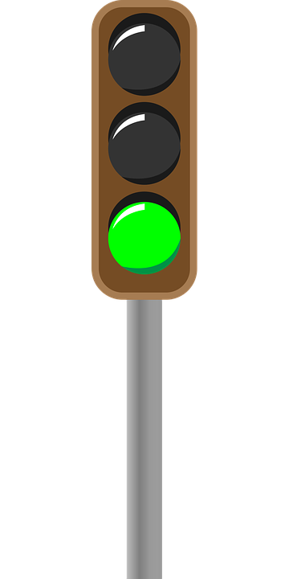
Lets go ……
Notes:
Disabled people and families have been clear about what is needed. Now is the time for positive change

Slide 3

Vision
In the future, disabled children and adults and their families will have greater choice and control over their supports and lives, and make more use of natural and universally available supports.
Notes:
The EGL vision provides the direction for change

Slide 4
EGL principles
    self determination
    beginning early
    person centred
    ordinary life outcomes
    mainstream first
    mana enhancing
    easy to use
    relationship building
Notes:
Self-determination
Disabled people are in control of their lives.
Beginning early
Invest early in families and whānau to support them; to be aspirational for their disabled child; to build community and natural support; and to support disabled children to become independent, rather than waiting for a crisis before support is available.
Person-centred
Disabled people have supports that are tailored to their individual needs and goals, and that take a whole life approach rather than being split across programmes.
Ordinary life outcomes
Disabled people are supported to live an everyday life in everyday places; and are regarded as citizens with opportunities for learning, employment, having a home and family, and social participation - like others at similar stages of life.
Mainstream first
Disabled people are supported to access mainstream services before specialist disability services.
Mana enhancing
The abilities and contributions of disabled people and their families are recognised and respected.
Easy to use
Disabled people have supports that are simple to use and flexible.
Relationship building
Supports build and strengthen relationships between disabled people, their whānau and community. The EGL principles provide the foundation for the change.

Slide 5
EGL Whakapapa
2008 – Select Committee
2009 Formation of the coalition
2010 Launch of Whānau Ora
2011 Day Services Review + EGL principles adopted
2012 Christchurch and Waikato Plans
2013 Local leadership – Waikato
2013 Christchurch demo launched
2013 EGL National Leadership
2017 MidCentral “prototype”
2022 Whaikaha established + EGL expanded
Notes:
The EGL approach came from disabled people and families.
Within the disability sector, there were high expectations that the recommendations from the Social Services Select Committee Inquiry would result in disabled people and family members having leadership of new innovations ie. a shifting of authority to achieve increased choice and control. Several organisations and networks, governed by disabled people and families, who had been strong contributors to the Select Committee Inquiry were poised to action some of the approaches they had fought to have acknowledged through this process.
Disabled people’s organisations and family organisations anticipated they would be enabled to use their knowledge, networks and skills to bring about increased choice and control for disabled people and their families. These organisations and networks were dismayed when, rather than their energy and experience being harnessed, the Ministry of Health appeared to “start from scratch”.
Frustration at a lack of progress was a significant catalyst for the formation of the” Coalition” (2009) and ultimately the Enabling Good Lives report (2011).

Slide 6
Important aspects of the EGL approach

Slide 7
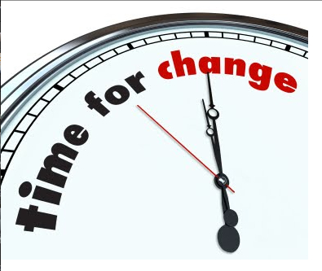
5 Elements for Systems Change
Building knowledge and skills of disabled people
Investment in family/whanau
Changes in communities
Changes to service provision
Changes to government systems and processes
Notes:
In the co-design we included the 5 elements for System Change.
Examples:
Capability and capacity resources for people, their family/whanau and communities
Helping prepare disabled people, their family/whanau and service providers for when System Transformation comes to and during the process of change in their community
Legislative changes

Slide 8
Characteristics of the Approach
Self-directed planning and facilitation
Cross-government individualised and portable funding
Considering the person in their wider context, not in the context of ‘funded support services’
Strengthening families and whānau
Community building to develop natural supports.
Notes:
The characteristics of the approach were developed to guide thinking about what was important to consider in the change process

Slide 9

Objectives of the EGL Approach
Individuals and family
Increased control.
Imaging a good life.
A plan is based on strengths, preferences and aspirations (dreams).
Personal budgets.
Access to an independent ally
Notes:
Individuals and their families have increased control over their lives.
Individuals and their families are able to imagine what a good life looks like for them and experience supports and services as something that makes this easier to achieve.
Individuals and families have one “plan”. In this plan individuals and families describe what they need and want to build a good life for themselves. This plan is based on strengths, preferences and aspirations (dreams). All supports, services and funders use the same plan as the key point of reference.
There is one pool of funding i.e. all government agencies will put the money into one “bucket”. Any funding is worked out on a person by person and/or family by family basis. Individuals and families have control of this funding
Individuals and families will have initial contact with an Independent Facilitator (Kaituhono/Navigator/Connector). They will be available to work with individuals and families in considering what a good life looks like for them and how they might achieve it. Note: Navigators do not decide on the level of funding. Individuals and families decide on the level of involvement they want with an Independent Facilitator (Navigator)

Slide 10
Ways to co-develop, influence and govern
Increased choice
Growing networks
Key roles with monitoring and evaluation
Notes:
Individuals and families will have input into designing and governing systems, supports and services.
Individuals and families have increased choice. These choices range from managing all of their resources themselves to choosing to buy support from service providers. Some individuals and families may choose a mix of options. Others may want the “say so” regarding their resources but have an organisation manage some or all of the tasks associated with making things happen.
Individuals and families will be able to connect with networks of disabled people and/or families to give them ideas about the choices they can make and the wide range of options that are possible
Individuals and families will have key roles in the monitoring and evaluation of any systems, supports and services e.g. the MEAL approach

Slide 11
Service providers will:
Have clarity
Implement a person/family directed approach
A single quality development approach
Adopt a “facilitation-based” approach
Make more use of universal supports and services
Experience a supportive system
Notes:
operate with a clear set of principles and expected outcomes
negotiate how they work on a person by person and/or family by family basis. Note: This will initially be informed by the disabled person’s plan.
experience one monitoring and evaluation process that is developmental.
operate according to a facilitation based approach i.e. make it easier for individuals and families to achieve their goals by tailoring supports rather than the provision of a set range of service types.
work to ensure community (generic) options are exhausted before specialist services are considered.
operate with significantly reduced bureaucratic restrictions and experience the “system” as being supportive of innovation.

Slide 12
Government departments will:
have shared principles and outcomes that guide their decisions and actions
have a shared monitoring and evaluation process.
ensure that all endeavours they fund directly or indirectly (e.g. workforce development) operate in accordance with the same principles and intent as Enabling Good Lives.
be trusting and trustworthy partners.

Slide 13

EGL Core ideas include:
Choice and Control
Diversity
Value of Family/Whānau
Positive change
A Unified Approach
Leadership by disabled people and families
Notes:
The intent of the Enabling Good Lives approach is to make changes so that disabled people and their families have control of their lives. This includes having the “say so” in how resources are used. An objective of Enabling Good Lives is to increase choice and not eliminate existing options
A diverse group of people is included in the term “disabled people”. Disabled persons and their families require different supports, services and approaches in order to achieve equity. Enabling Good Lives recognises people live in varied communities. With the Enabling Good Lives approach, some things will be the same around the country (i.e. principles, general outcomes and monitoring processes) but some communities may need to do things differently to suit their specific circumstances and preferences.
The Enabling Good Lives approach respects the central importance of family/whānau.
Enabling Good Lives is both about a whole new way of doing things (i.e. systems change) and about supports and services doing things in different ways (i.e. service transformation). The Enabling Good Lives approach is based on the belief that for disabled people and family/whānau to experience real choice and control, complete system change is required i.e. Enabling Good Lives is not an “add on” to the existing system
Enabling Good Lives stresses the critical importance of change being across Ministries, ‘joined up’, strategic and consistent with the expectation and aspiration expressed by disabled people and family/whānau
Disabled people, their organisations and family/whānau national networks must have key roles in both National and Regional Governance of the system’s transformation and the new approaches that are created

Slide 14
Moving to a Facilitation Based Approach
Community
Building a Better Way
Notes:
All supports and services will move towards an approach that makes it easier for disabled people and their families to create good lives for themselves in the community i.e. towards ‘facilitation’ and away from ‘provision’
A primary focus for services is to assist disabled people and families to access and contribute to community based (generic) options, supports and services
All Enabling Good Lives initiatives are developed with the reasonable expectation they can improve supports and services according to the perspective of disabled persons and their families i.e. do no harm

